Slide 1
Introduction to .NET Core 7 and C# Training

Slide 2
Agenda
Introduction
What is .NET Core?
C# Language Fundamentals
Object-Oriented Programming in C#
Advanced C# Concepts
Introduction to .NET Core 7
Building Web Applications with ASP.NET Core
.. More

Slide 3
Introduction
NET Core is a modern, open-source, cross-platform development framework created by Microsoft. It provides a powerful and flexible platform for building a wide range of applications, including web, desktop, and cloud-based solutions. Its cross-platform nature and support for modern development practices make it a preferred choice for developers aiming to build cutting-edge applications. Throughout this session, we will explore the key features and benefits of .NET Core and discover how it can empower you to develop innovative software solutions.

Slide 4
Overview
NET Core is an open-source, cross-platform development framework developed by Microsoft.
Key features of .NET Core 7 include performance improvements, new APIs, etc.
C# is a powerful, object-oriented programming language used for developing applications on the .NET platform.
In this training, will learn the fundamentals of C# programming and explore the features and capabilities of .NET Core 7.

Slide 5
C# Language Fundamentals
C# is a statically typed, strongly typed language with a rich set of built-in types. This means that variables in C# must be declared with their specific type, and the type checking is enforced by the compiler. C# provides various built-in types, including integers (int), strings, booleans (bool), and more, allowing developers to work with different kinds of data.
Variables and data types: C# supports a wide range of data types that represent different kinds of information. For example, the integer type (int) is used to store whole numbers, the string type represents sequences of characters, and the boolean type (bool) is used to store true or false values. Developers declare variables by specifying their type and can assign values to them using the assignment operator (=).

Slide 6
Object-Oriented Programming in C#
Object-oriented programming concepts: C# is an object-oriented programming (OOP) language. OOP is centered around the concepts of encapsulation, inheritance, and polymorphism. Encapsulation involves bundling data and related behaviors into objects, allowing for data protection and abstraction. Inheritance enables the creation of hierarchies of classes, where derived classes inherit properties and behaviors from a base class. Polymorphism allows objects to be treated as instances of their parent classes, providing flexibility and code reuse.

Slide 7
Advanced C# Concepts
Generics and collections: Generics in C# allow developers to create reusable and type-safe code. With generics, classes, interfaces, and methods can be parameterized by type, enabling the creation of generic data structures and algorithms. This flexibility allows developers to write code that can handle different types without sacrificing type safety. In terms of collections, C# provides a variety of built-in collection classes such as lists, dictionaries, and queues. These collections offer efficient ways to store, manipulate, and retrieve data, catering to different requirements and use cases.

Slide 8
Advanced C# Concepts
Exception handling: Exception handling in C# allows developers to gracefully handle and manage unexpected situations that can cause program execution to halt or produce incorrect results. Using try-catch blocks, developers can catch and handle exceptions, providing alternative paths of execution or displaying meaningful error messages. Additionally, exception filters allow for more fine-grained exception handling based on specific conditions. Finally blocks can be used to ensure that certain code executes, regardless of whether an exception occurred or not, such as releasing resources.

Slide 9
Advanced C# Concepts
Delegates and events: Delegates in C# provide a way to encapsulate and pass methods as parameters, enabling powerful and flexible programming patterns. Delegates act as a reference to a method, allowing them to be assigned, passed as arguments, and invoked dynamically. This capability is particularly useful when implementing callbacks or handling events. Events in C# provide a mechanism for implementing the observer pattern, where an object can notify and communicate with other objects when a particular action or state change occurs. Events allow for decoupled and efficient event handling, promoting modularity and extensibility in applications.

Slide 10
Advanced C# Concepts
LINQ (Language-Integrated Query): LINQ is a powerful feature in C# that allows developers to write query-like expressions to query, filter, and manipulate data from different data sources such as collections, databases, and XML. LINQ provides a unified syntax that enables developers to write expressive and readable code, making data querying and manipulation more intuitive. LINQ queries are strongly typed, which helps catch errors at compile-time and promotes code correctness. With LINQ, developers can easily perform operations like filtering, sorting, grouping, and joining data, greatly simplifying data access and transformation tasks.

Slide 11
A(){B()}
B(){C()}

Slide 12
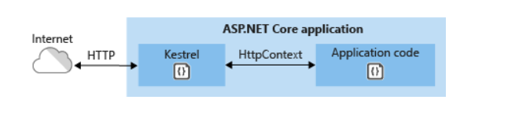
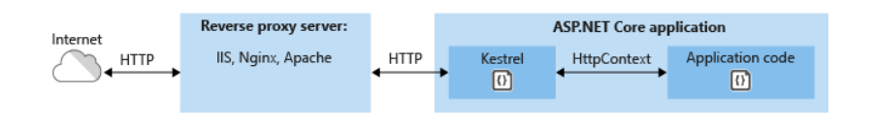
Web Application Hosting Options
Kestral
IIS, Apache, Nginx
Diagrams from https://docs.microsoft.com/en-us/aspnet/core/fundamentals/servers/?view=aspnetcore-2.2&tabs=windows

Slide 13
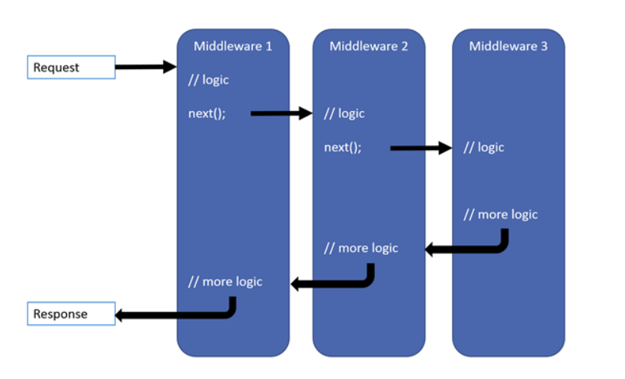
Asp.Net Core Pipeline
Provides an application pipeline that supports pluggable services
Pipeline services are delivered via a Dependency Injection Container
The pipeline is configured with one or more components.
Middleware components pass Requests to next component via Request Delegates.
Each component configures a lambda that binds to a Request Delegate, defining its processing and invoking a next() function.
When a Request arrives the middleware delegate sequence is invoked.

Slide 14
Middleware
Middleware is software that's assembled into an app pipeline to handle requests and responses. Each component:
Chooses whether to pass the request to the next component in the pipeline.
Can perform work before and after the next component in the pipeline.
Request delegates are used to build the request pipeline. The request delegates handle each HTTP request.

Slide 15
Configuring Middleware
You configure pipeline middleware using the Configure method, provided by the Startup class.
Services include:
Serving static files
MVC routing and operations
Custom services
Service lifetime:
AddSingletonService<IService, Service>() Singleton service used for the lifetime of the Application
AddScopedService<IService, Service>() Singleton service used for the duration of one HTTP request
AddTransientService<IService, Service>() Created with each request for service, possibly many times per HTTP request

Slide 16
Middleware provided by the framework - partial list
Authenication
Cookie Policy
CORS
Diagnostics
HTTPS Redirection
MVC
Routing
Session
Static Files
URL Rewriting
WebSockets

Slide 17
Startup
Startup Class
ConfigureServices method
Registers a service interface and implementing class for dependency injection using one of the AddService methods, described in the previous slide
Each AddService adds a service to the Dependency Injection Services container.
Configure method
Creates the application’s pipeline with app.UseXXX() invocations.
app.Run( some write method )
An app.UseXXX invocation need not pass a message down the pipeline.
App.Run executes only if all app.UseXXX() middleware pass along the request message.
Essentially, the pipeline is the sequence of app.UseXXX() methods in StartupConfigure()

Slide 18
Building Web Host
IWebHostBuilder CreateWebHostBuilder(string[] args)
Creates a host and defines the Startup Assembly
IWebHostBuilder methods:
Build()
…
Extension methods:
Start(IWebHostBuilder, String[])
UseConfiguration(IWebHostBuilder, IConfiguration)
UseServer(IWebHostBuilder, IServer)
UseStartup(IWebHostBuilder, String)
…

Slide 19
app.Run
app.Run(…) is similar to app.UseXXX(),
but does not send on a request.
It is the pipeline terminus.

